Slide 1
Grocify — Online Grocery Store System
Supervised By
Dr. Gurpreet Singh
Nidhish Kamboj (2210990606) Hardik Garg (2210990355)
Department of Computer Science and Engineering, Chitkara University, Punjab

Slide 2
Introduction
Grocify is a web-based online grocery shopping platform designed to bring the convenience of supermarket shopping to users' fingertips.
The system allows customers to browse products by category, search for items, view detailed product information, and complete purchases through a streamlined interface.
Built with a clean, intuitive UI featuring a navigation bar, search functionality, cart management, and user login — all accessible from every page.
Categories covered include: Fruits & Vegetables, Dairy & Eggs, Beverages, Bakery, Snacks, Personal Care, and Condiments & Spices
Tagline: "Groceries Made Easy"

Slide 3
Objective
To develop a fully functional web-based grocery store that enables customers to shop online without visiting a physical store
To provide an organised, category-based product browsing experience for ease of navigation
To implement a product detail system showing real-time pricing, stock availability, and item descriptions
To facilitate a smooth cart and purchase workflow — from product selection to checkout
To build a scalable platform that can host multiple product categories and support a growing product catalogue
To create an accessible and responsive design that works for a wide range of users

Slide 4
Problem Statement
Traditional grocery shopping requires physical presence, which is time-consuming and inconvenient for busy individuals
Customers often face challenges such as limited store hours, long queues, unavailability of specific products, and a lack of product information
Small grocery retailers lack a digital presence, making it difficult to compete with supermarket chains
There is a need for an affordable, easy-to-use online platform that bridges the gap between local grocery stores and digital consumers
Existing solutions are often complex or inaccessible for smaller stores — Grocify aims to solve this with a lightweight, straightforward web application

Slide 5
Methodology
System Architecture:
Web-based application with a multi-page structure: Homepage, Products Page, Product Detail Pages, and About Page
Key Modules Developed:-
Homepage, Hero banner, product categories grid, featured products section
Products Page Category sidebar filter + product card grid with price & stock
Product Detail: Full image, description, price, stock level, Add-to-Cart with quantity selector
About Page, Brand mission statement, store imagery, contact information
Navigation: Global search bar, Cart icon, Login control — available on all pages
Development Approach
: Feature-by-feature iterative development
Screenshot-based system documentation for all major user flows
Category-driven filtering for improved product discoverability

Slide 6
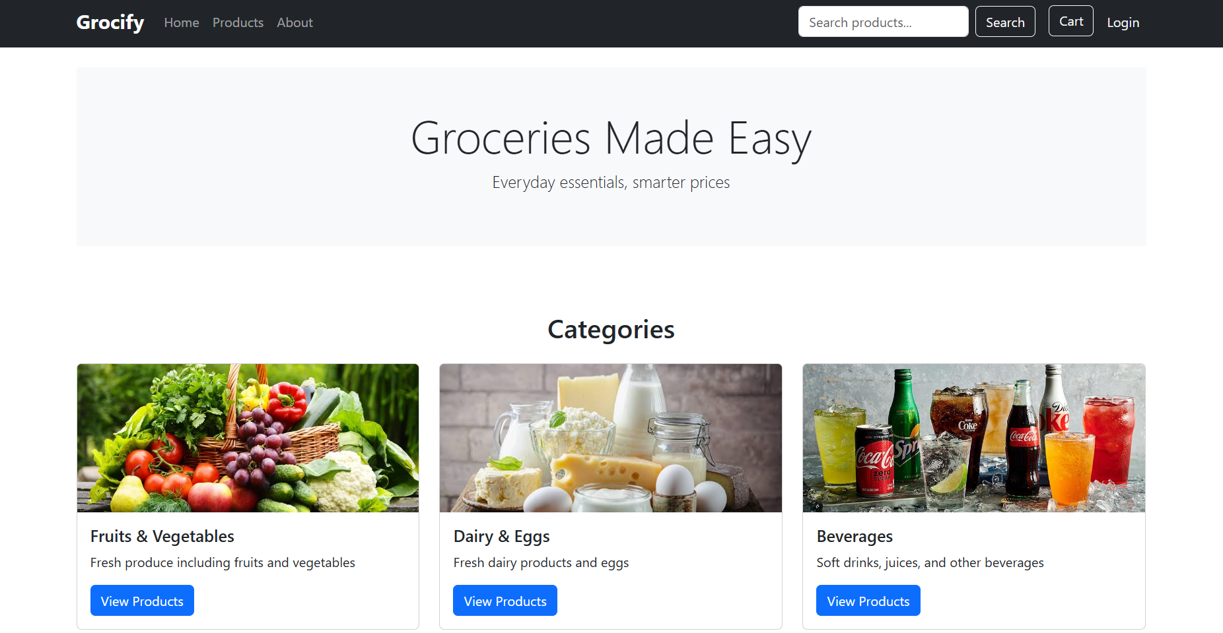
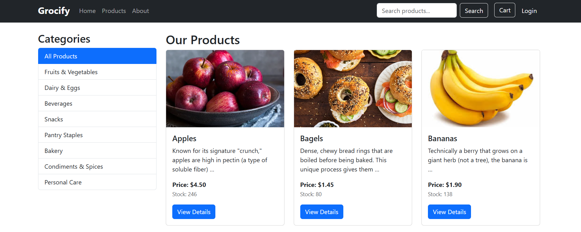
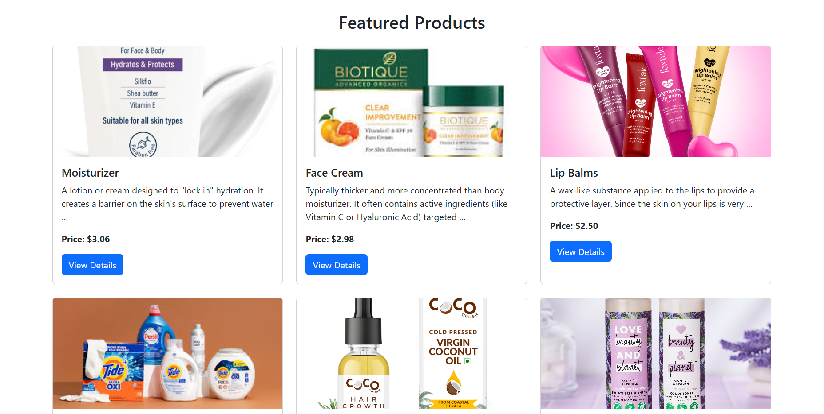
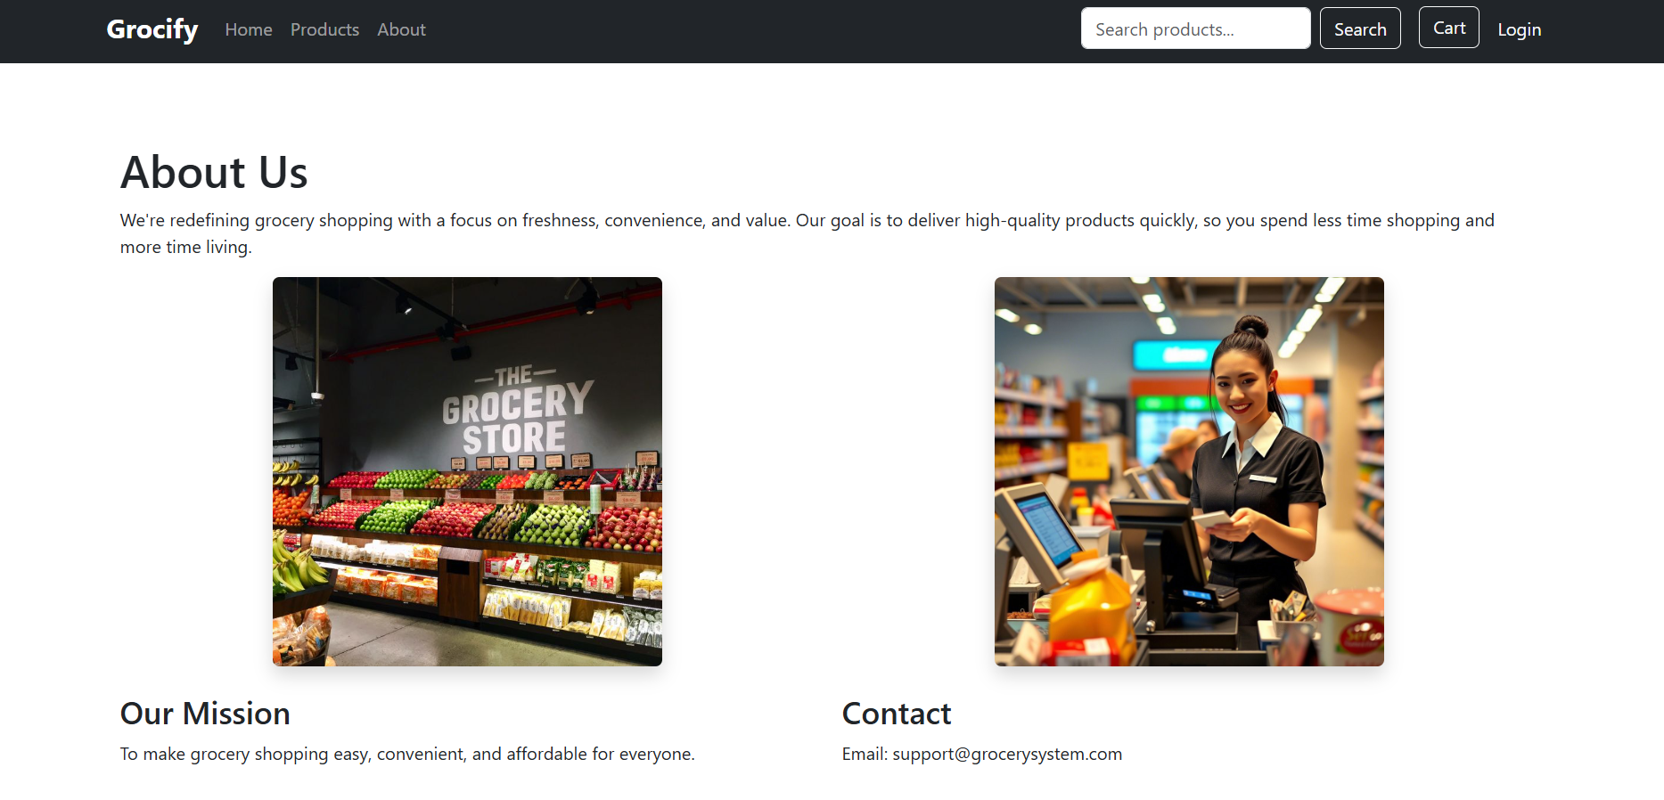
Project UI

Slide 7
Results & Discussion
System Successfully Delivers:
A clean, browsable homepage with category cards (Fruits & Vegetables, Dairy & Eggs, Beverages, etc.) and a Featured Products section
A fully functional Products page with a sidebar category filter enabling users to narrow down searches efficiently
Detailed product pages for all items — e.g., Cakes ($3.50, 50 units), Chips ($0.40, 99 units), Face Cream ($2.98, 100 units), Black Pepper ($0.50, 60 units)
Real-time stock visibility and quantity-controlled Add-to-Cart functionality on product detail pages
An informative About page with brand mission and contact details, building customer trust
Discussion: The system effectively reduces the friction of grocery shopping by digitising the browsing and purchasing experience
Category-based filtering and stock level display directly improve user decision-making
The consistent navigation bar across all pages ensures a seamless browsing experience
Featured Products section drives product discovery for new or curated items

Slide 8
Conclusion
Grocify successfully demonstrates a functional, user-friendly online grocery store system with core e-commerce features
The platform covers the complete customer journey — from discovering categories on the homepage to viewing product details and adding items to the cart
The system addresses real-world pain points: convenience, product transparency (pricing & stock), and accessible design
Future enhancements could include: user account management, order history, payment gateway integration, delivery tracking, and an admin panel for inventory management
Grocify lays a strong foundation for a scalable digital grocery solution that can benefit both consumers and small grocery retailers

Slide 9
Thank You
3

